Slide 1
Web Programming
MOD002619
Week 6
Django Forms and Filters

Slide 2
Session content
Recap
HTML Forms
GET v POST
Django Forms

Slide 3
6.1 Recap
Web Programming
Week 6 Part 6.1

Slide 4
Recap
Simple Site
  Uses Bootstrap with
    Centered Hero on Home
    Simple Navigation Bar
    Pagination
  Listing pages showing Students and Modules accessed from both call-to-action buttons on home page and navigation bar options
  Simple detail pages for both single student and module.
Currently no editing capability apart from via the Admin Pages

Slide 5
6.2 HTML Forms
Web Programming
Week 6 Part 6.2

Slide 6
HTML Form Element
The <form> element is used to provide the user with interactive elements and controls.
Key attributes:
  name – Cannot be an empty string and must be unique amongst the form elements
  action – The URL that process the form data
See Mozilla.org for full details

Slide 7
Input Types
Within the form element we can define multiple input types eg:
Table from W3Schools
Type | Description
<input type="text"> | Displays a single-line text input field
<input type="radio"> | Displays a radio button (for selecting one of many choices)
<input type="checkbox"> | Displays a checkbox (for selecting zero or more of many choices)
<input type="submit"> | Displays a submit button (for submitting the form)
<input type="button"> | Displays a clickable button

Slide 8
The form method attribute
The HTTP method to submit the form with. The only allowed methods/values are (case insensitive):
  post: The POST method; form data sent as the request body.
  get (default): The GET; form data appended to the action URL with a ? separator. Use this method when the form has no side effects.
  dialog: When the form is inside a <dialog>, closes the dialog and causes a submit event to be fired on submission, without submitting data or clearing the form.
  Mozilla.org

Slide 9
6.3 HTML POST v GET
Web Programming
Week 6 Part 6.3

Slide 10
HTML GET
We have been using GET requests as a matter of course in our current application – these can be seen in the terminal we run our server in:
  [18/Jun/2026 12:52:38] "GET /student/543/ HTTP/1.1" 200 1734
As mentioned above if we use GET to pass data from a user input for the data will be appended to the URL in plain text for all to see.
  Clearly a security risk
    https://example.com/login?username=alice&password=SuperSecret123
  Could also be visible in
    Browser address bar, browser history, server logs, proxy logs …

Slide 11
HTML POST
With a HTML POST the data is not visible in the URL but encoded in the actual request.
  See mo##zilla.org for more details.
As such when using forms always use POST to send data rather than GET
  For high security applications it would be best to use HTTPS rather than plain HTTP
We have been using POST when entering uour user name and password into the admin app:
  [18/Jun/2026 13:09:52] "GET /admin/ HTTP/1.1" 302 0
  [18/Jun/2026 13:09:52] "GET /admin/login/?next=/admin/ HTTP/1.1" 200 4080
  [18/Jun/2026 13:09:52] "GET /static/admin/css/login.css HTTP/1.1" 304 0
  [18/Jun/2026 13:10:03] "POST /admin/login/?next=/admin/ HTTP/1.1" 302 0
  [18/Jun/2026 13:10:03] "GET /admin/ HTTP/1.1" 200 8767

Slide 12
6.4 Django Forms
Web Programming
Week 6 Part 6.4

Slide 13
Django Forms
Django has a form class:
  Looks a lot like a Model
  Describes a form and determines how it works and appears.
  A form’s fields are themselves classes; they manage form data and perform validation when a form is submitted.
  A form field is represented to a user in the browser as an HTML “widget”
  Can be bound to a Model
  See the Django documentation for more details.

Slide 14
Handling Post Data (typical views.py)
from django.http import HttpResponseRedirect
from django.shortcuts import render
from .forms import NameForm
def get_name(request):
# if this is a POST request we need to process the form data
if request.method == "POST":
# create a form instance and populate it with data from the request:
form = NameForm(request.POST)
# check whether it's valid:
if form.is_valid():
# process the data in form.cleaned_data as required
# ...
# redirect to a new URL:
return HttpResponseRedirect("/thanks/")
# if a GET (or any other method) we'll create a blank form
else:
form = NameForm()
return render(request, "name.html", {"form": form})
A form class that we will create will lokk at a typical one later

Slide 15
Handling Post Data (typical views.py) 1
from django.http import HttpResponseRedirect
from django.shortcuts import render
from .forms import NameForm
def get_name(request):
# if this is a POST request we need to process the form data
if request.method == "POST":
# create a form instance and populate it with data from the request:
form = NameForm(request.POST)
# check whether it's valid:
if form.is_valid():
# process the data in form.cleaned_data as required
# ...
# redirect to a new URL:
return HttpResponseRedirect("/thanks/")
# if a GET (or any other method) we'll create a blank form
else:
form = NameForm()
return render(request, "name.html", {"form": form})
Overloaded constructor uses POST data to construct a Form object bound to the post data

Slide 16
Handling Post Data (typical views.py) 2
from django.http import HttpResponseRedirect
from django.shortcuts import render
from .forms import NameForm
def get_name(request):
# if this is a POST request we need to process the form data
if request.method == "POST":
# create a form instance and populate it with data from the request:
form = NameForm(request.POST)
# check whether it's valid:
if form.is_valid():
# process the data in form.cleaned_data as required
# ...
# redirect to a new URL:
return HttpResponseRedirect("/thanks/")
# if a GET (or any other method) we'll create a blank form
else:
form = NameForm()
return render(request, "name.html", {"form": form})
Ensure our form is valid before we do anything

Slide 17
Handling Post Data (typical views.py) 3
from django.http import HttpResponseRedirect
from django.shortcuts import render
from .forms import NameForm
def get_name(request):
# if this is a POST request we need to process the form data
if request.method == "POST":
# create a form instance and populate it with data from the request:
form = NameForm(request.POST)
# check whether it's valid:
if form.is_valid():
# process the data in form.cleaned_data as required
# ...
# redirect to a new URL:
return HttpResponseRedirect("/thanks/")
# if a GET (or any other method) we'll create a blank form
else:
form = NameForm()
return render(request, "name.html", {"form": form})
Each field in a Form class is responsible not only for validating data, but also for “cleaning” it – normalizing it to a consistent format.

Slide 18
Handling Post Data (typical views.py) 4
from django.http import HttpResponseRedirect
from django.shortcuts import render
from .forms import NameForm
def get_name(request):
# if this is a POST request we need to process the form data
if request.method == "POST":
# create a form instance and populate it with data from the request:
form = NameForm(request.POST)
# check whether it's valid:
if form.is_valid():
# process the data in form.cleaned_data as required
# ...
# redirect to a new URL:
return HttpResponseRedirect("/thanks/")
# if a GET (or any other method) we'll create a blank form
else:
form = NameForm()
return render(request, "name.html", {"form": form})
For a GET just create an empty unbound form. This would be our initial entry point – presenting the user with an empty form – or one populated with default data

Slide 19
6.5 Forms Walkthrough - Student
Web Programming
Week 6 Part 6.5

Slide 20
Process
At the moment we have a simple student_detail.html template that just presents the data for an individual student. We be able to edit the data.
  Add an edit option to the student list
  Create a form class that is bound to our model for Student
  Create a view to instantiate a form and pass it to our template
  Create a template to display the form
  Handle the return to be able to save the edits to the database

Slide 21
Add an Edit Button to the Student List
{% for student in page_obj %}
<tr>
<th scope="row">
<a href="{% url 'myApp:student_detail’
student.id %}">
{{student.id}}
</th>
<td>{{student.firstName|capfirst}}</td>
<td>{{student.lastName|upper}}</td>
<td>
<input class="btn btn-light" type="button" value="Edit"
onclick="location.href='{% url 'myApp:student_edit’ student.id %}'">
</td>
</tr>
{% endfor %}

Slide 22
Create a form class
forms.py
from django import forms
from django.forms import fields
from .models import Student, Module
class StudentEditForm(forms.ModelForm):
class Meta:
model = Student
fields = ['firstName',
'lastName',
'age',
'email',
'enrolmentDate',
'modules',
'image', ]

Slide 23
Create a view to instantiate a form
from .forms import StudentEditForm
def student_edit(request, student_id):
studentForm = StudentEditForm()
context={'studentForm':studentForm, 'student_id':student_id}
return render(request, "student_edit.html", context )

Slide 24
Template to display the form
student_edit.html
{% extends "base.html" %}
{% block content %}
<form action="{% url 'myApp:student_edit' student_id %}" method="POST" enctype="multipart/form-data" >
{% csrf_token %}
{{ studentForm }}
<input type="submit" value="Edit Student">
</form>
{% endblock %}

Slide 25
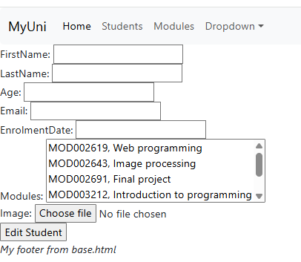
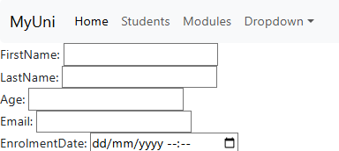
Resulting Form
We can improve this by defining specific widgets.
E.g. adding a date time picker for enrolmentDate – in the Form Meta class:
widgets = {
"enrolmentDate":
forms.DateTimeInput(
attrs={"type":
"datetime-local"}
)
}
Not particularly good looking

Slide 26
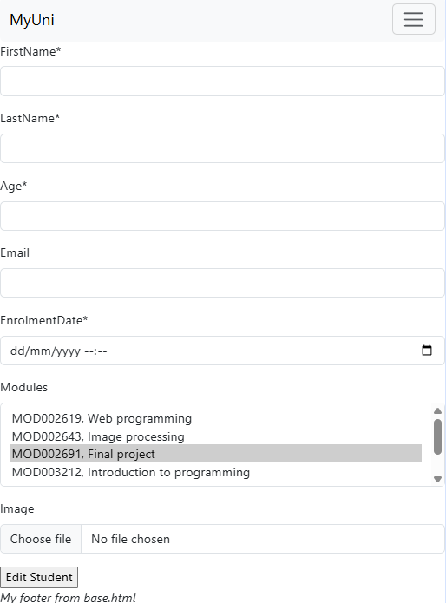
Adding BootStrap to Forms
For bootstrap we need to install CrispyForms
pip install django-crispy-forms crispy-bootstrap5
Add the apps to settings.py:
INSTALLED_APPS = [
…
"crispy_forms",
"crispy_bootstrap5",
…
]
…
CRISPY_ALLOWED_TEMPLATE_PACKS = "bootstrap5“
CRISPY_TEMPLATE_PACK = "bootstrap5"
Load the crispy tags in your template:
<form action="{% url 'myApp:student_edit' student_id %}" method="POST" enctype="multipart/form-data">
{% csrf_token %}
{% load crispy_forms_tags %}
{{ studentForm|crispy }}
<input type="submit" value="Edit Student">
</form>

Slide 27
Save the Edits to the Database
from django.shortcuts import get_object_or_404
def student_edit(request, student_id):
student = get_object_or_404(Student, pk=student_id)
print(f'Loaded student image: {student.image}')
if request.method == "POST":
# create a form instance and populate it with data from the request:
form = StudentEditForm(request.POST, request.FILES, instance=student)
# check whether it's valid:
if form.is_valid():
form.save()
# Redirect to student details page showing edits
return redirect("myApp:student_detail", student_id=student_id )
else:
studentForm = StudentEditForm(instance=student)
context={'studentForm':studentForm, 'student_id':student_id}
return render(request, "student_edit.html", context )

Slide 28
6.6 Django Filters
Web Programming
Week 6 Part 6.6

Slide 29
Django Filter Class
Django’s Filter Class enables to to create simple filtering of our student list for things such as:
  Students whose first name contains a specified string
  Students who are over a certain age
  Students enrolled on a specific module
First we must install the library:
pip install django-filter
Then add the libar to the installed apps in settings.py:
  INSTALLED_APPS = [
  ...
  "django_filters",
  ...
  ]

Slide 30
Example Filter Class for Student
import django_filters
from .models import Student
class StudentFilter(django_filters.FilterSet):
class Meta:
model = Student
fields = {'firstName' :['icontains'],
'lastName' : ['icontains'],
'age' : ['lt', 'gt'],
'modules__code' : ['exact'],
'modules__name' : ['icontains']
}

Slide 31
Example Filter Class for Student 1
A dictionary of the fields to produce filters for. Here we are using the firstName attribute from the Student model
import django_filters
from .models import Student
class StudentFilter(django_filters.FilterSet):
class Meta:
model = Student
fields = {'firstName' :['icontains'],
'lastName' : ['icontains'],
'age' : ['lt', 'gt'],
'modules__code' : ['exact'],
'modules__name' : ['icontains']
}

Slide 32
Example Filter Class for Student 2
The filter type these are defined in the Django Documentation. This is a character filter for contained case insensitive strings and would generate SQL similar to:
SELECT ... WHERE … ILIKE '%Lennon%';
import django_filters
from .models import Student
class StudentFilter(django_filters.FilterSet):
class Meta:
model = Student
fields = {'firstName' :['icontains'],
'lastName' : ['icontains'],
'age' : ['lt', 'gt'],
'modules__code' : ['exact'],
'modules__name' : ['icontains']
}

Slide 33
Example Filter Class for Student 3
Filters can be combined in the list here so we would generate two number filters here one for greater than and one for less than
import django_filters
from .models import Student
class StudentFilter(django_filters.FilterSet):
class Meta:
model = Student
fields = {'firstName' :['icontains'],
'lastName' : ['icontains'],
'age' : ['lt', 'gt'],
'modules__code' : ['exact'],
'modules__name' : ['icontains']
}

Slide 34
Example Filter Class for Student 4
Using the double underscore syntax here “__” we can traverse the many to many relationship defined in our module to return all the students who are enrolled on the module with the exact module code provided.
import django_filters
from .models import Student
class StudentFilter(django_filters.FilterSet):
class Meta:
model = Student
fields = {'firstName' :['icontains'],
'lastName' : ['icontains'],
'age' : ['lt', 'gt'],
'modules__code' : ['exact'],
'modules__name' : ['icontains']
}

Slide 35
Filter the Selection in the View
def studentlist(request, page):
students = Student.objects.all().order_by("lastName")
filter = StudentFilter(request.GET, queryset=students)
paginator = Paginator(filter.qs, 20)
page_obj = paginator.get_page(page)
page_obj.adjusted_elided_pages = paginator.get_elided_page_range(page, on_each_side=1, on_ends=1)
context = {"page_obj": page_object, "filter":filter}
return render(request,'studentlist.html', context)

Slide 36
Filter the Selection in the View 1
def studentlist(request, page):
students = Student.objects.all().order_by("lastName")
filter = StudentFilter(request.GET, queryset=students)
paginator = Paginator(filter.qs, 20)
page_obj = paginator.get_page(page)
page_obj.adjusted_elided_pages = paginator.get_elided_page_range(page, on_each_side=1, on_ends=1)
context = {"page_obj": page_object, "filter":filter}
return render(request,'studentlist.html', context)
Create a student filter object using the HTTP GET and our students result set

Slide 37
Filter the Selection in the View 2
def studentlist(request, page):
students = Student.objects.all().order_by("lastName")
filter = StudentFilter(request.GET, queryset=students)
paginator = Paginator(filter.qs, 20)
page_obj = paginator.get_page(page)
page_obj.adjusted_elided_pages = paginator.get_elided_page_range(page, on_each_side=1, on_ends=1)
context = {"page_obj": page_object, "filter":filter}
return render(request,'studentlist.html', context)
Use the filter’s query set to create our paginator

Slide 38
Filter the Selection in the View 3
def studentlist(request, page):
students = Student.objects.all().order_by("lastName")
filter = StudentFilter(request.GET, queryset=students)
paginator = Paginator(filter.qs, 20)
page_obj = paginator.get_page(page)
page_obj.adjusted_elided_pages = paginator.get_elided_page_range(page, on_each_side=1, on_ends=1)
context = {"page_obj": page_object, "filter":filter}
return render(request,'studentlist.html', context)
Add the filter to the context to pass on to our template

Slide 39
Add the Filter Form to the Template
studentlist.html
...
<form method="get">
{% load crispy_forms_tags %}
{{ filter.form | crispy }}
<input type="submit" />
</form>
<table class="table table-striped table-hover">
...

Slide 40
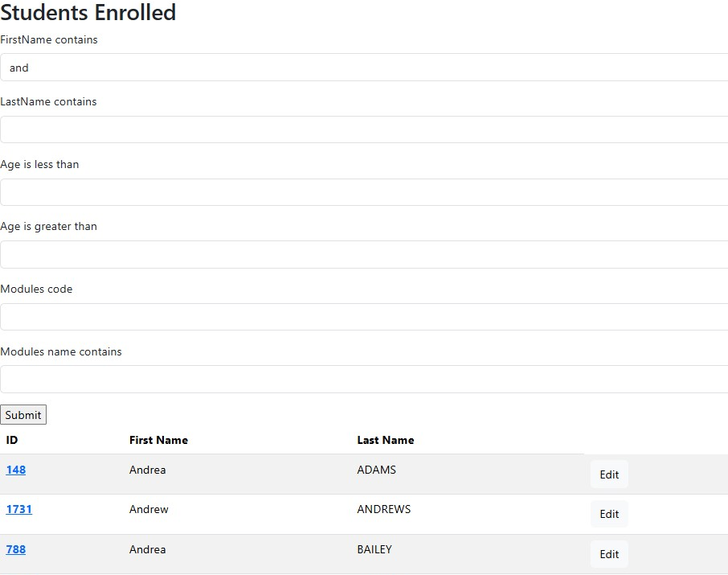
Example Filter Form
Here is a default output using “and” as the First Name filter and clicking submit.
There are a number of issues
If we hit the next button or one of the page buttons, we lose the filters. Returning to a full list on the specified page number.
If the user enters data such that no records are returned we will get an error page
The form entry labels are not great

Slide 41
GET Issue
We can see the problem in our console:
[25/Jun/2026 12:17:23] "GET /studentlist/1/ HTTP/1.1" 200 11302
[25/Jun/2026 12:19:38] "GET /studentlist/1/?firstName__icontains=and&lastName__icontains=&age__lt=&age__gt=&modules__code=&modules__name__icontains= HTTP/1.1" 200 11814
[25/Jun/2026 12:24:36] "GET /studentlist/2/ HTTP/1.1" 200 11665
The first GET here is from our student button on the homepage
The second GET is from the submit from the filter form and contains the data the user entered firstName__icontains=and,
The final get is from the next button in our paginator block.
We need to preserve the GET arguments.
To do this we need to pass the query string from our view through to our template

Slide 42
Update View
In the view
querydict = request.GET.copy()
context = {
"filter": filter,
"page_obj": page_obj,
"query_string": urlencode(querydict),
}
In the template modify all the link reference to pass on this query string e.g.
href="{% url 'myApp:studentlist' page_obj.next_page_number %}?{{ query_string }}"

Slide 43
Handle No Records
In the Template:
{% if page_obj.paginator.count == 0 %}
<table class="table table-striped table-hover">
<thead class="thead-dark">
<tr> <th scope="col">ID</th> <th scope="col">First Name</th> <th scope="col">Last Name</th> </tr>
</thead>
<tbody>
<th scope="row" colspan=3><p class="text-center">No Records Returned.</p></th>
</tbody>
</table>
<p class="text-center">No Records Returned.</p>
{% else %}
<table class="table table-striped table-hover">
...
{% endif %}

Slide 44
Add Constructor to Filter
filters.py
def __init__(self, *args, **kwargs):
super().__init__(*args, **kwargs)
self.form.fields["firstName__icontains"].label = "First Name"
self.form.fields["lastName__icontains"].label = "Last Name"
self.form.fields["modules__code"].label = "Module Code"
self.form.fields["modules__name__icontains"].label = "Module Name"

Slide 45
Identifying the Filter Names
Add the line below to your view:
print(f"Filter names: {StudentFilter().form.fields.keys()})
It will print the filter nnames out to the console for you
Filter names: dict_keys(['firstName__icontains', 'lastName__icontains', 'age__lt', 'age__gt', 'modules__code', 'modules__name__icontains’])
Note the two age filters lt and gt

